Slide 1
Moving to CLoud
Session 13
Course : COMP6584001 – Network and Systems Programming
Ivan Sebastian Edbert

Slide 2
Learning Objectives
At the end of this session, the student will be expected to :
Understand the concept of Cloud
Able to use Cloud Feature

Slide 3
Outline
AWS Lambda
Google Cloud Functions
Azure Functions

Slide 4
AWS Lambda

Slide 5
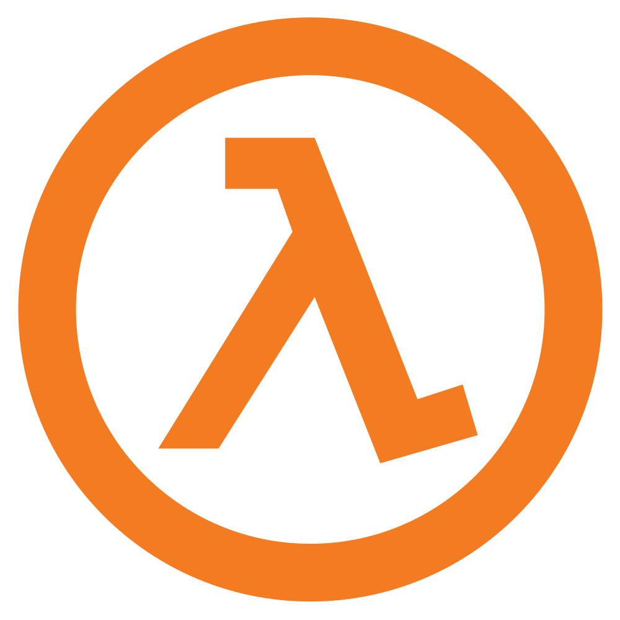
aws lambda
AWS lambda is a on demand compute service.
AWS Lambda is a serverless, event-driven compute service that lets you run code for virtually any type of application or backend service without provisioning or managing servers. You can trigger Lambda from over 200 AWS services and software as a service (SaaS) applications, and only pay for what you use.
Instead of having a computer running listening to your request, you have a function or logic saved on AWS. Some kind of event, for example, making a request to API gateway endpoint or uploading something to S3 will trigger the function and the function will execute on one of the servers Amazon provisions within milliseconds.
That function for example could resize an image in one of your buckets.

Slide 6
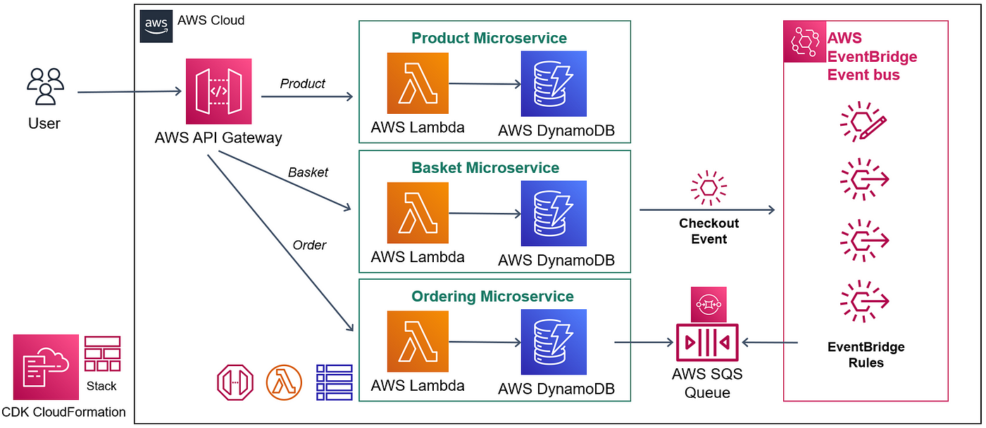
Aws Lambda
How AWS lambda works

Slide 7
Aws lambda
Why use aws lambda?
Serverless Architecture:
Lambda enables a serverless architecture, allowing developers to focus on writing code without the need to provision, manage, or scale servers. This simplifies the development process and reduces operational overhead.
Automatic Scaling:
AWS Lambda automatically scales based on the number of incoming requests. It can handle a virtually unlimited number of requests, scaling both up and down as needed. This ensures optimal performance without manual intervention.
Pay-as-You-Go Pricing:
Lambda follows a pay-as-you-go pricing model, where you are charged based on the number of requests and the duration of code execution. You only pay for the compute resources used during the actual execution of your code.

Slide 8
Aws lambda
Why use aws lambda?
Event-Driven Architecture:
Lambda functions are triggered by events, such as changes to data in S3, updates to a DynamoDB table, or HTTP requests via API Gateway. This event-driven model is well-suited for building reactive and scalable applications.
Multi-Language Support:
Lambda supports multiple programming languages, including Node.js, Python, Java, C#, Go, and more. This flexibility allows developers to choose the language that best suits their application requirements.
Integration with AWS Services:
Lambda seamlessly integrates with various AWS services, enabling you to build comprehensive serverless applications. Common integrations include API Gateway for building RESTful APIs, S3 for file storage, DynamoDB for NoSQL databases, and more.

Slide 9
Aws lambda
Why use aws lambda?
Microservices Architecture:
Lambda functions are small, single-purpose units of computation, making them well-suited for a microservices architecture. You can compose applications from multiple Lambda functions, each responsible for a specific task.
Rapid Development and Deployment
With Lambda, you can quickly develop and deploy functions without the need to manage infrastructure. This agility is especially beneficial for prototyping, testing, and iterating on applications.
Low Maintenance Overhead:
Lambda seamlessly integrates with various AWS services, enabling you to build comprehensive serverless applications. Common integrations include API Gateway for building RESTful APIs, S3 for file storage, DynamoDB for NoSQL databases, and more.

Slide 10
Aws lambda
Why use aws lambda?
Built-in Fault Tolerance:
Lambda automatically replicates functions across multiple availability zones, providing built-in fault tolerance. If one availability zone experiences issues, the function can still be executed in another zone.
Global Reach:
Lambda functions can be deployed in multiple AWS regions, allowing you to build applications with a global reach. This is beneficial for minimizing latency and ensuring responsiveness for users worldwide.
Event Logging and Monitoring:
AWS Lambda provides built-in logging and monitoring through Amazon CloudWatch. You can easily track and analyze function executions, set up alarms, and gain insights into application performance.

Slide 11
Google cloud Functions

Slide 12
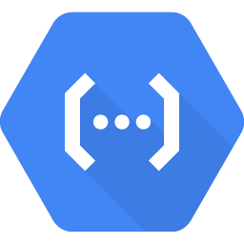
Google Cloud Functions
Google Cloud Functions is a serverless compute service provided by Google Cloud Platform (GCP). Like AWS Lambda, it allows developers to run event-triggered functions without managing the underlying infrastructure.
Google Cloud Functions is a powerful tool for building serverless applications on Google Cloud Platform. It is particularly well-suited for developers who are already using or planning to use other GCP services as part of their application architecture.

Slide 13
Google cloud functions
Why google cloud functions?
Serverless Computing:
Cloud Functions abstracts the infrastructure, allowing developers to focus on writing code without the need for server provisioning, scaling, or maintenance.
Language Support:
Google Cloud Functions supports multiple programming languages, including Node.js, Python, Go, Java, .NET, and more. This flexibility allows developers to choose the language that best suits their expertise and application requirements.
Automatic Scaling:
Google Cloud Functions scales automatically in response to the number of incoming requests. It can handle a high volume of concurrent executions and scales down to zero when there is no traffic, minimizing costs.

Slide 14
Google cloud functions
Why google cloud functions?
Triggers and Binding:
Cloud Functions use triggers to specify the event that will invoke the function. Additionally, developers can use Cloud Function bindings to interact with other GCP services in a serverless manner.
Environment Variables:
Google Cloud Functions allows the use of environment variables to store configuration settings, API keys, and other sensitive information.
Monitoring and Logging:
Google Cloud Functions integrates with Cloud Monitoring and Cloud Logging, providing visibility into function executions. Developers can set up alerts, monitor performance metrics, and analyze logs.

Slide 15
Azure

Slide 16

Azure
Azure, also known as Microsoft Azure, is a comprehensive cloud computing platform provided by Microsoft.
It offers a wide range of cloud services and solutions, enabling organizations to build, deploy, and manage applications and services through Microsoft's global network of data centers.
Azure is Microsoft's public cloud platform. Azure offers a large collection of services, which includes platform as a service (PaaS), infrastructure as a service (IaaS), and managed database service capabilities

Slide 17
azure
Why use azure
Compute Services:
Azure provides various compute services, including virtual machines (VMs), Azure Kubernetes Service (AKS) for container orchestration, Azure Functions for serverless computing, and Azure Batch for large-scale parallel processing.
Storage Services:
Azure offers scalable and secure storage solutions such as Azure Blob Storage (for object storage), Azure File Storage (for file shares), Azure Table Storage (NoSQL data store), and Azure Queue Storage (for messaging between application components).
Database Services:
Azure provides a range of database services, including Azure SQL Database (relational database), Azure Cosmos DB (globally distributed, multi-model database), Azure Redis Cache (in-memory caching), and more.

Slide 18
azure
Why use azure
Networking:
Azure offers networking services for building and managing network infrastructure. This includes Azure Virtual Network, Azure Load Balancer, Azure VPN Gateway, Azure Application Gateway, and Azure CDN (Content Delivery Network).
Identity and Access Management:
Azure Active Directory (Azure AD) is Microsoft's identity and access management service, providing secure authentication and authorization for applications and users.
Security and Compliance:
Azure includes a range of security features, including Azure Security Center for threat protection, Azure Policy for compliance management, and Azure Key Vault for managing cryptographic keys and secrets.

Slide 19
azure
Why use azure
AI and Machine Learning:
Azure AI services enable developers to build AI-powered applications. This includes Azure Machine Learning for building, training, and deploying machine learning models, and Azure Cognitive Services for pre-built AI capabilities.
Internet of Things (IoT):
Azure IoT services help organizations connect, monitor, and manage IoT devices. This includes Azure IoT Hub, Azure IoT Central, and Azure Sphere for secure and scalable IoT solutions.
Analytics and Big Data:
Azure offers services for big data and analytics, such as Azure HDInsight (managed Hadoop, Spark, and more), Azure Data Lake Storage, Azure Databricks (collaborative Apache Spark-based analytics platform), and Azure Synapse Analytics (formerly SQL Data Warehouse).

Slide 20
Tips choosing cloud

Slide 21
Tips to choose cloud provider
The choice between AWS Lambda, Google Cloud Functions, or Azure Functions depends on various factors, including your specific requirements, existing infrastructure, development preferences, and the features offered by each cloud provider. Here are some considerations to help you make a decision:
Platform Familiarity:
If your team is already familiar with a specific cloud platform, it may be advantageous to stick with that platform. Consider the existing skill set and knowledge within your organization.
Integration with Existing Services:
Consider the services and tools that each cloud provider offers and how well they integrate with your existing or planned infrastructure. Each platform has its ecosystem of services, and choosing one that aligns with your needs can simplify integration.

Slide 22
Tips to choose cloud provider
Programming Language Support:
Check the programming languages supported by each serverless platform. Choose a platform that supports the languages you are comfortable with or that aligns with your application requirements.
Scalability and Performance:
Assess the scalability and performance characteristics of each serverless platform. Look at how well they handle scaling, concurrent executions, and the latency of function invocations.
Pricing Model:
Compare the pricing models of AWS Lambda, Google Cloud Functions, and Azure Functions. Consider how each platform charges for compute resources, requests, and execution time. Choose the pricing model that aligns with your budget and usage patterns.

Slide 23
references
Adam Woodbeck - Network Programming with Go_ Learn to Code Secure and Reliable Network Services from Scratch-No Starch Press (2021).
https://aws.amazon.com/lambda/
https://cloud.google.com/functions
https://azure.microsoft.com/en-us

Slide 24
Thankyou

